Slide 1
ONLINE PARKING SYSTEM
BY – ASHISH, VINAY, KOMAL

Slide 2
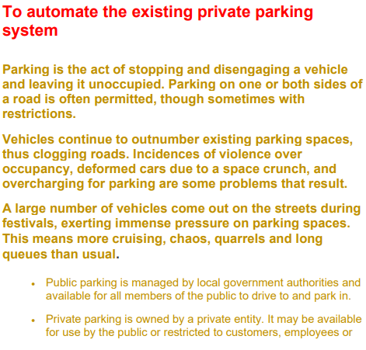
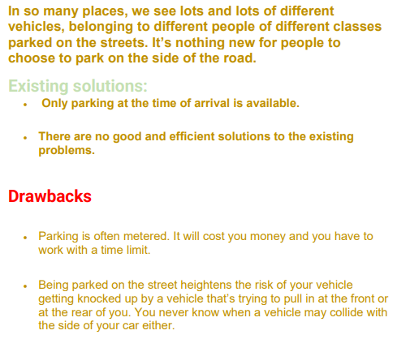
CHAPTER - 1
1.1. Problem Statement 1.2. Limitations of Current System

Slide 3
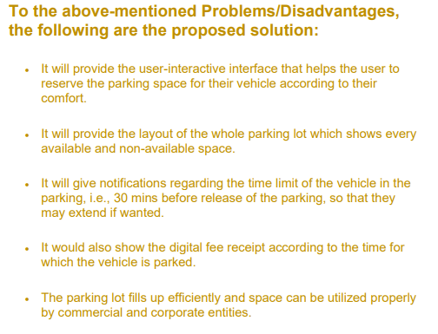
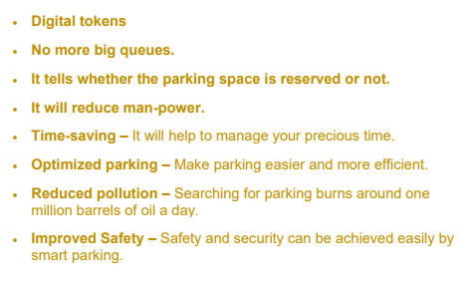
1.3. Proposed System Solution 1.4. Advantages of Proposed Solution

Slide 4
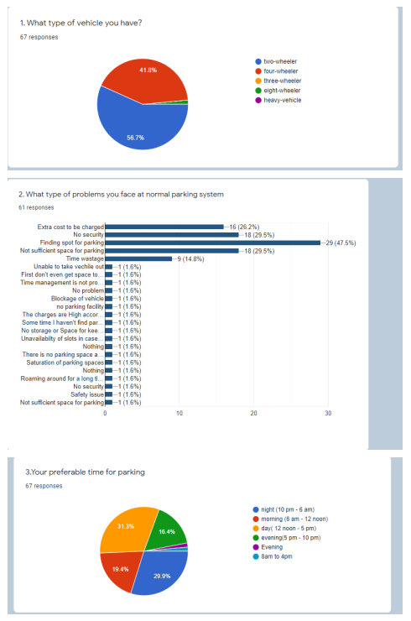
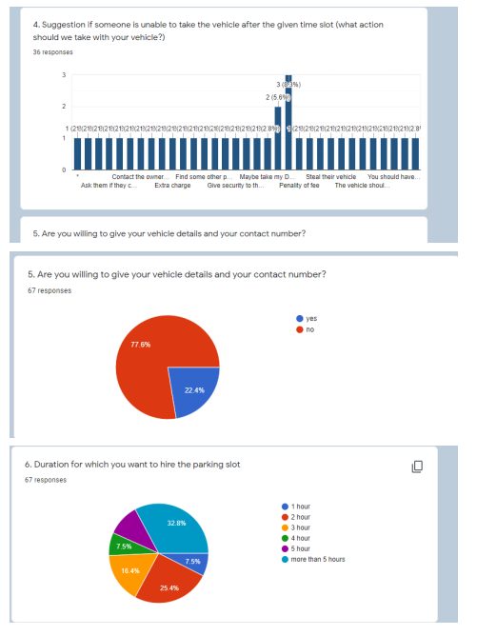
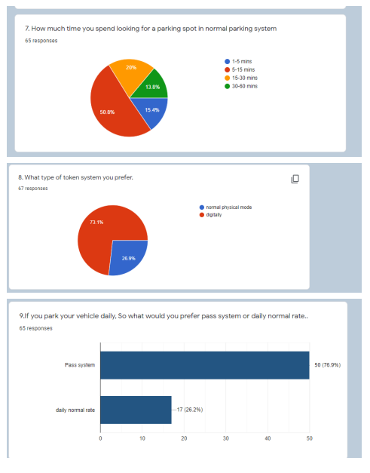
1.5 GOOGLE FORM LINK AND RESPONSES

Slide 5
CHAPTER - 2
2.1.1 Purpose
The main purpose of our system is to make the parking facility easier and more convenient and to develop an app which automates the parking system. This document serves as the guide for the users of this app
2.1.2 Document Conventions
The SRS document is designed as per the IEEE 830-1998 standard SRS template.
2.1.3 Intended Audience and Reading suggestion
The intended audience for the system is the users of the app. The users will be the general people seeking for the parking space availability in the parking area. Admin is able to block any particular slot and can manage parking charges

Slide 6
2.1.4 Product scope
In scope:
Users can book slots for parking.
Users can choose the time duration of parking.
Users can see the way to the parking slot.
Users can unbook the slot.
Users can see their parking History.
Out of Scope:
Management of more vehicles than the limited space.
2.1.5 References
IEEE 830-1998 standard SRS template IEEE SRS Template.

Slide 7
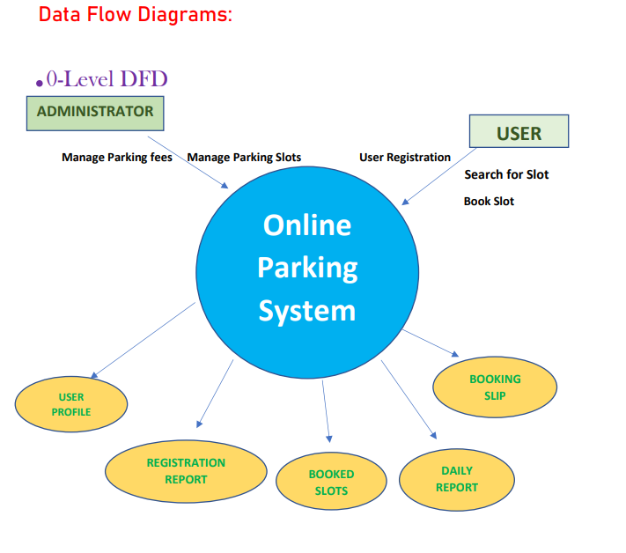
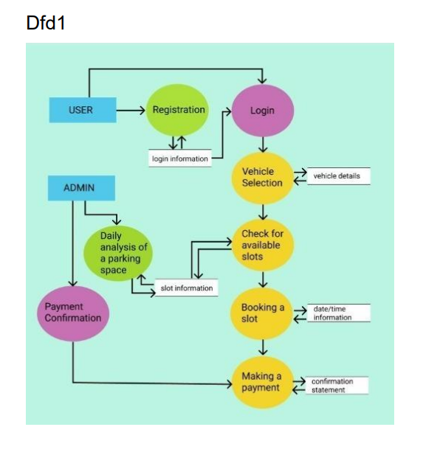
2.2 OVERALL DESCRIPTION
2.2.1 Product Prospective:

Slide 8
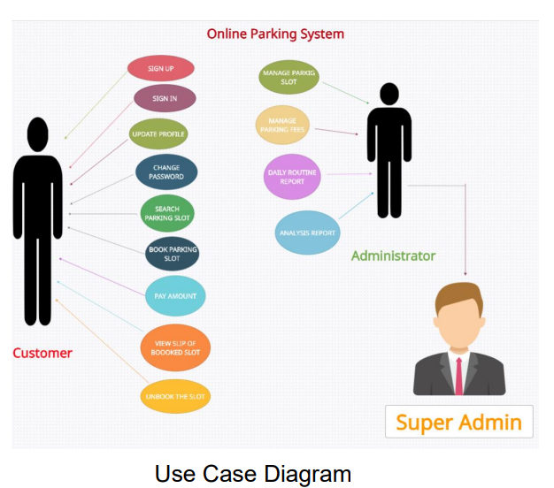
2.2.2 PRODUCT FUNCTIONS

Slide 9
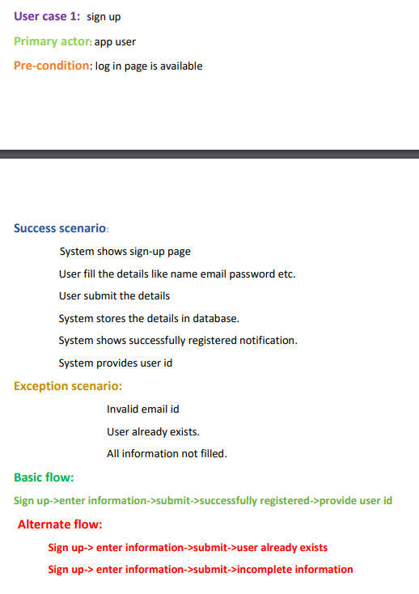
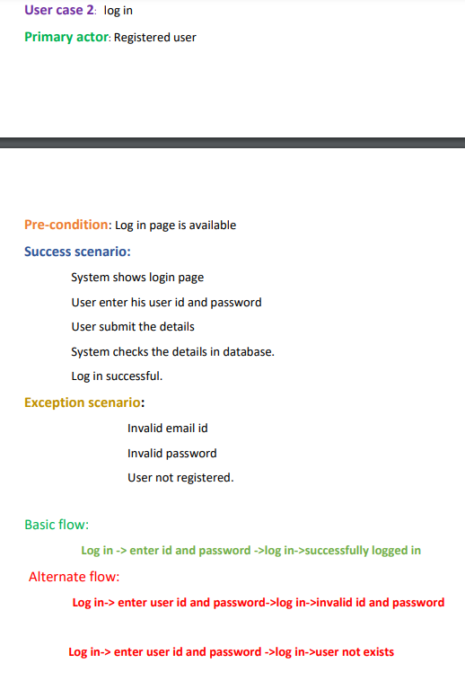

Slide 10
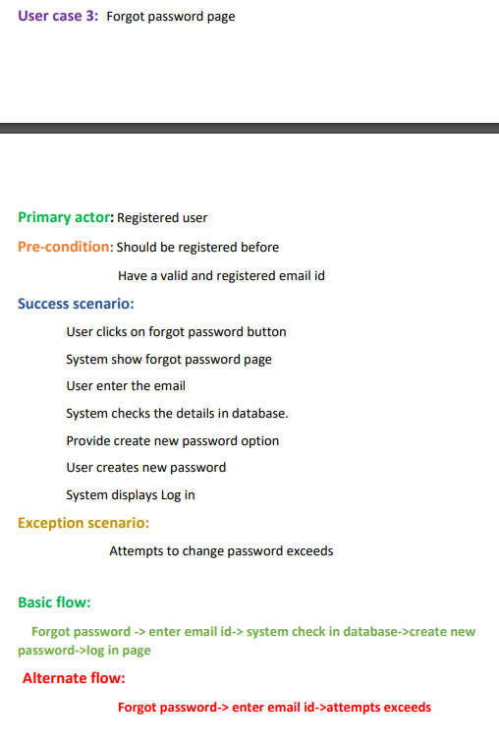
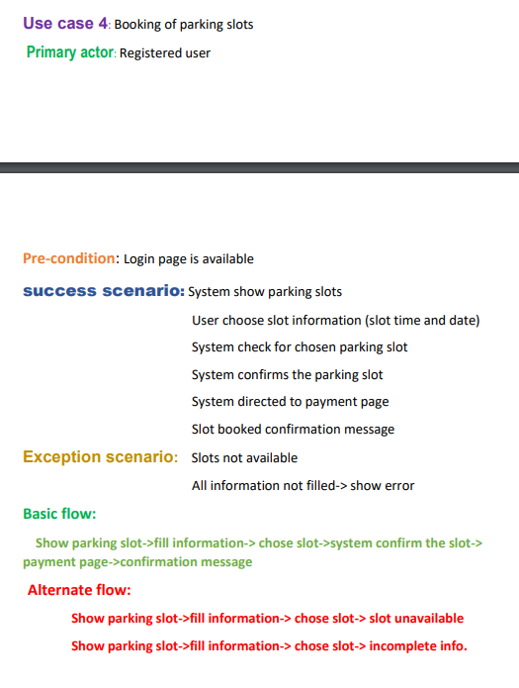

Slide 11
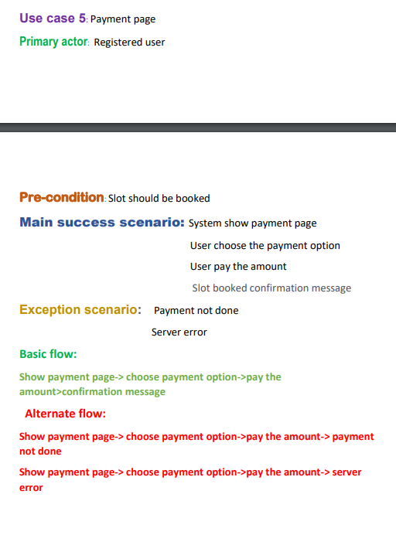
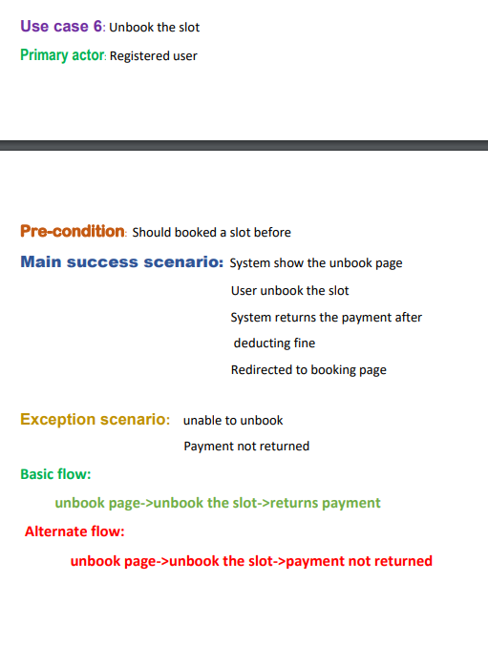

Slide 12
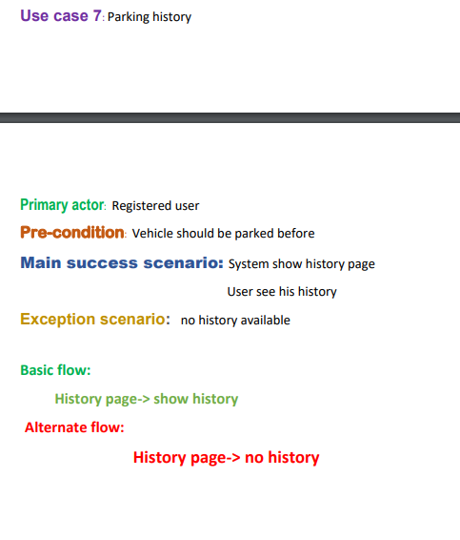
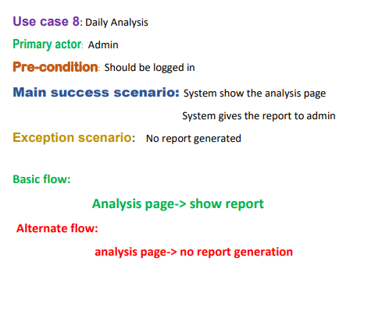

Slide 13
2.2.3 USER CLASSES AND CHARACTERISTICS
General User
a. Users will be able to use the app to book Parking slots.
b. Users can manage their timing and can view their parked History.
2. Admin
a. Manage parking slots
b. Manage parking fees
c. Able to keep track of booked slots
3. Super Admin
a. Manage all important information and view records

Slide 14
2.2.4 Operating Environment
The app will operate on mobile devices for both android and iOS. An internet connection is a must
2.2.5 Design and Implementation Constraints
1. Only English language is supported.
2. Users have Android or iOS based devices.
3. User must have correct password and user-id to login
4. Booking of slots will depend upon the availability of slots and timing.
2.2.6 Assumptions and Dependencies
1. All the data entered will be correct and up to date.
2. The user is connected to the internet and is willing to share personal Information online.

Slide 15
2.3 EXTERNAL INTERFACE REQUIREMENTS.
2.3.1 User Interfaces
GUI (Graphical User Interface)
2.3.2 Hardware Interfaces
1) OS - Android/iOS
Android version 7.0 (Nougat) and up
IOS version 8.1.3 and up
2) Storage - 200 MB
3) RAM – 312 MB
2.3.3 Software Interfaces
HTML, CSS, JAVASCRIPT, PHP OS - Android Studio Database- SQL
2.3.4 Communications Interfaces
1.Android
2.SMS Service protocol
3.POP protocol
4. TCP/IP

Slide 16
2.4 SYSTEM FEATURES
2.4.1 Sign up
2.4.2 Login
2.4.3 Booking of Parking Slot
2.4.4 Payment of Booked Parking Slot
2.4.5 Unbooking of Parking Slot

Slide 17
2.4.1 SIGN UP
2.4.1.1 Description
This functionality is available for all the users of the app. Users can sign up using correct information.
2.4.1.2 Stimulus/Response Sequence
1. Start of App
2.Entering Valid information like Email, name, password.
3. signed up
2.4.1.3 Functional Requirements
Internet Connectivity and Data usage Permission is Necessary

Slide 18
2.4.2 LOGIN
2.4.2.1 Description
This functionality is available for all the users of the app.
Users can login using identical login information.
2.4.2.2 Stimulus/Response Sequence
1. Start of App
2.Entering Valid Login Credentials
3. Logged In
2.4.2.3 Functional Requirements
Internet Connectivity and Data usage Permission is Necessary Users should be signed Up for the App.

Slide 19
2.4.3 BOOKING OF PARKING SLOT
2.4.3.3 Functional Requirements
Internet connectivity is a must.
2. Users must verify their identity using a suitable verification or they won't be able to use this function.
2.4.3.1 Description
This functionality is only available for the registered user. The user will be able to book a parking slot for an unoccupied space.
2.4.3.2 Sequence
1.User has to login to the app.
2.Choose the unoccupied slot
3. Enter vehicle details like vehicle no.
4. choose preferable time
5. Enter Identity Verification details like (Aadhar card no.)
6. pay the booking charge
7. Slot is Booked.

Slide 20
2.4.4 PAYMENT OF BOOKED PARKING SLOT
2.4.4.3 Functional Requirements
Internet connection is must.
Users must have online payment system.
2.4.4.1 Description
This functionality is only available for the registered user who already booked a slot.
User will be able to pay the booking charge for the parked slot.
2.4.4.2 Sequence
1. User has to book slot.
2. Choose the payment method
3. Enter payment details like (UPI).
4. pay the booking charge.
5. Payment is successful.

Slide 21
2.4.5 UNBOOKING OF PARKING SLOT
2.4.5.1 Description
This functionality is only available for the registered user who already booked a slot.
The user will be able to unbook a parking slot which he already booked
2.4.5.2 Sequence
1. User has to select the booked slot.
2. Choose the unbook option
3. Pay the unbooking charge.
4. Slot is unbooked.
2.4.5.3 Functional Requirements
1. Internet connectivity is must.
2. Users must book a slot before otherwise they won't be able to use this function.

Slide 22
2.5 OTHER NON-FUNCTIONAL REQUIREMENTS
2.5.1 Performance Requirements
Response time-The system will give responses within 1 second after checking the user information and other information.
Capacity-The system must support 1000 people at a time .
User interface- User interface screen will be very responsive.

Slide 23
2.5.2 Safety Requirements
If any failure happens in the database, such as a disk crash, the recovery method can be used to restore a past copy of the database that was backed up in storage.
2.5.3 Security Requirements
All the admins have unique logins so the system can only be accessed by those with login. Only system Admins can change records and valuable data. No intruders allowed.
2.5.4 Availability
App can be downloaded from Google play store or Apple store

Slide 24
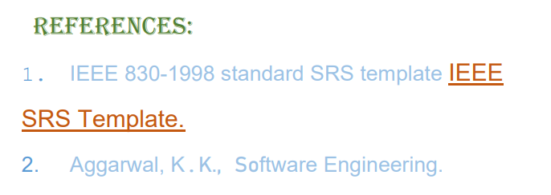
2.5.5 Software Quality Attributes
App will be available 24*7. It can be accessed on any device that meets the minimum requirement.
Modularity: App is modular.
Maintainability: Source code of software will be easy to maintain.
Usability: software can be used again and again without distortion.
Accessibility: Administrator and many other users can access the system but the access level is controlled for each user according to their work scope.
Accuracy: The reliability of the information and output. Can depend on and be sure of the outcome

Slide 25

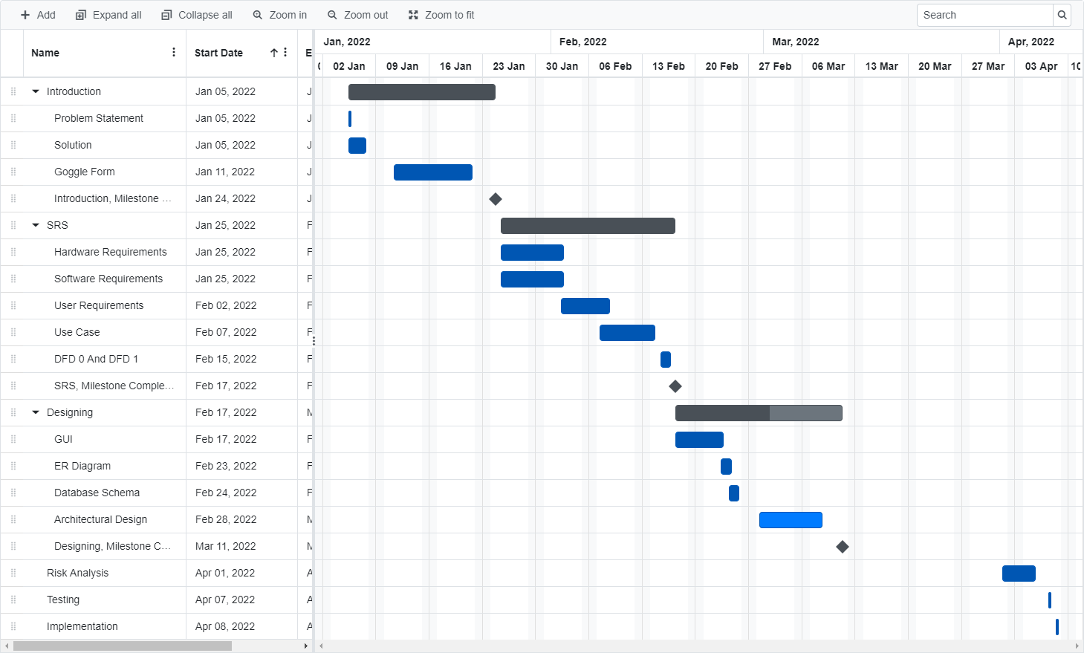
CHAPTER - 3

Slide 26

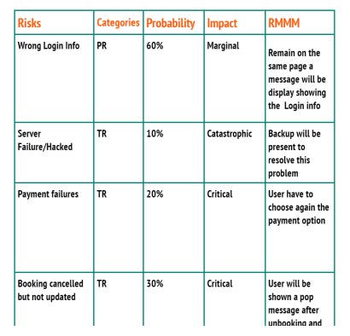
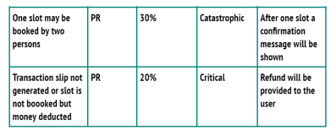

Slide 27

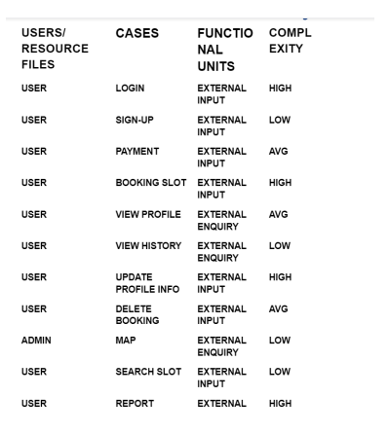
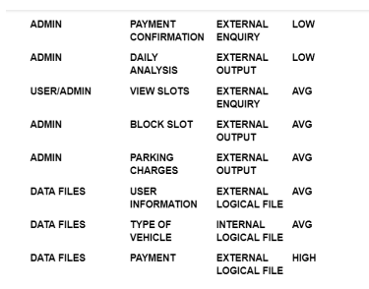

Slide 28
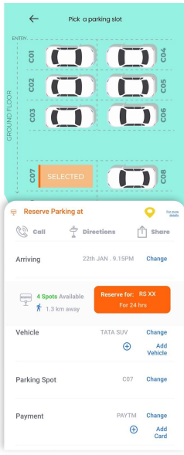
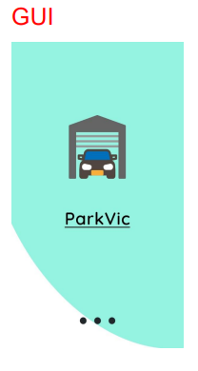
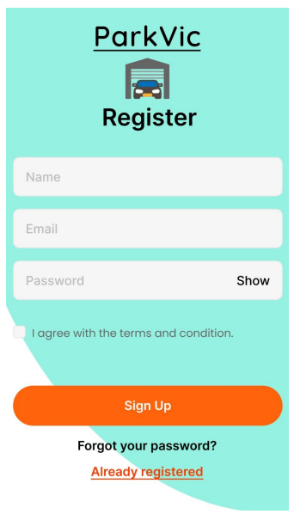
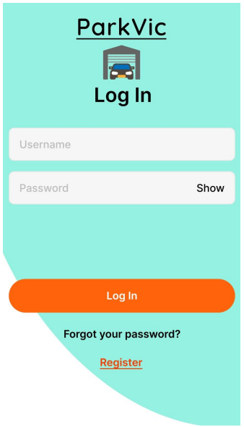
CHAPTER - 4

Slide 29
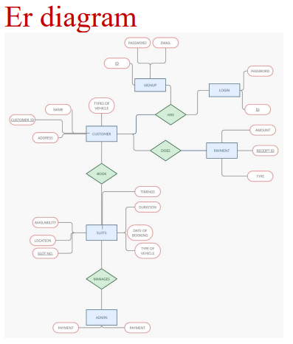

Slide 30
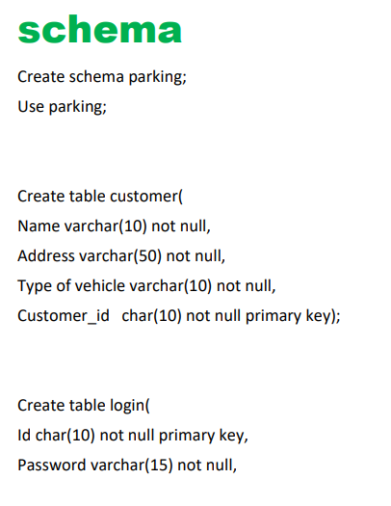
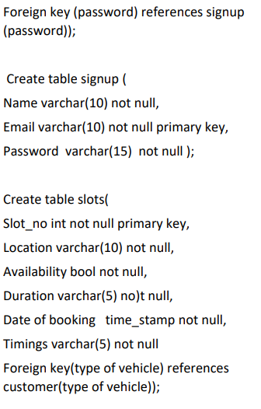
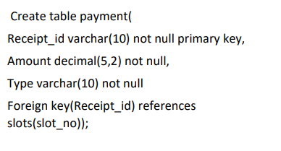

Slide 31
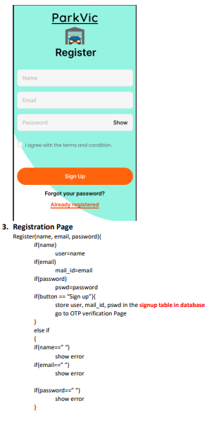
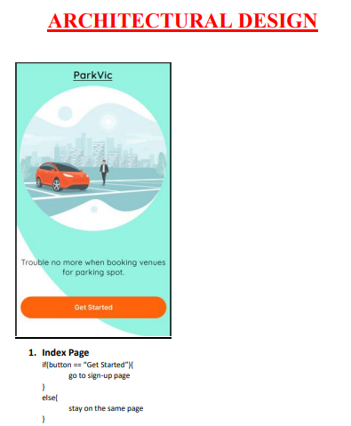
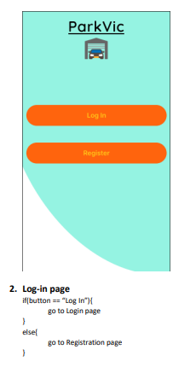

Slide 32
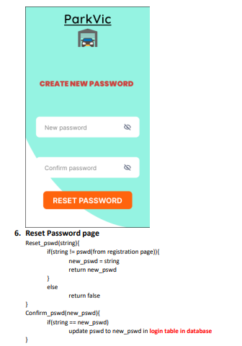
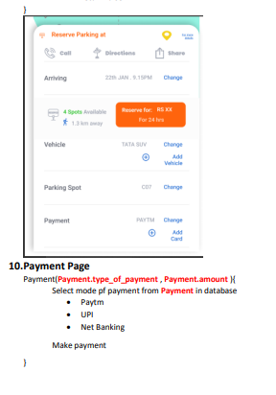
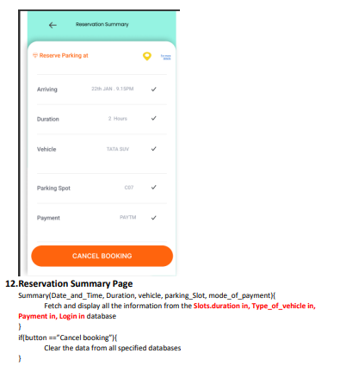

Slide 33
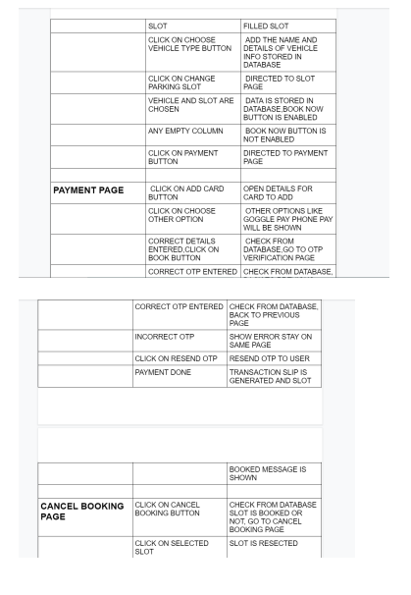
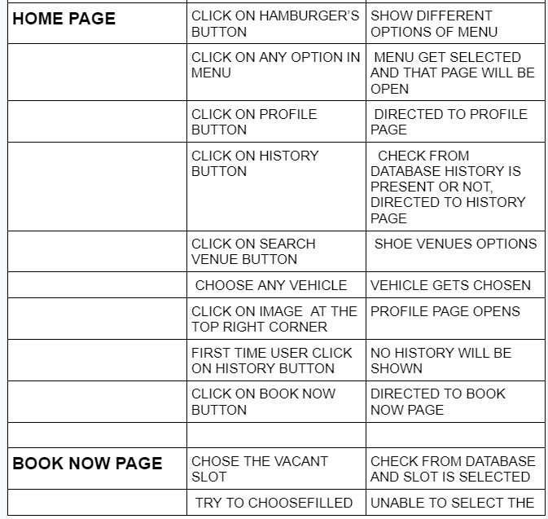
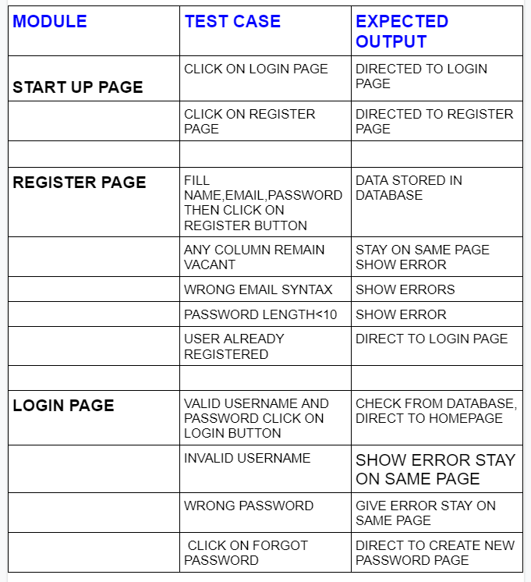
CHAPTER - 5
TEST CASES

Slide 34
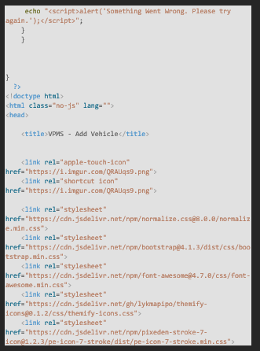
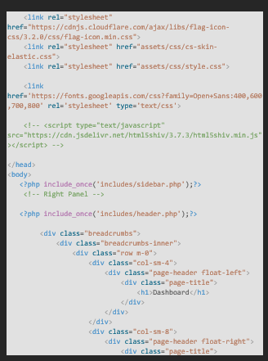
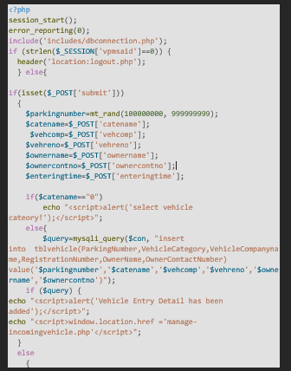
Cyclomatic complexity

Slide 35
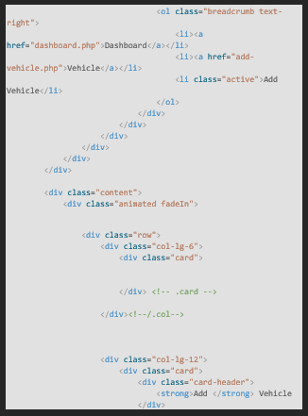
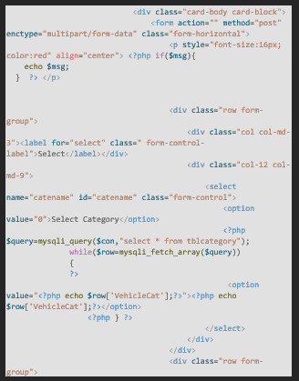
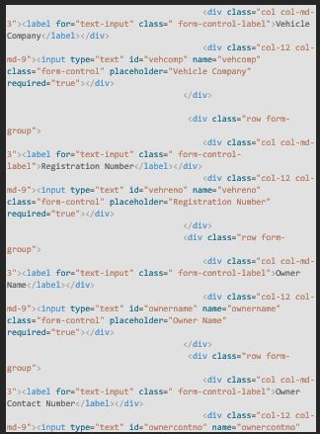

Slide 36
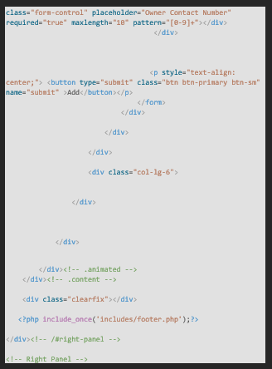
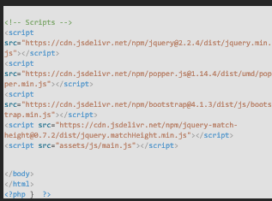

Slide 37
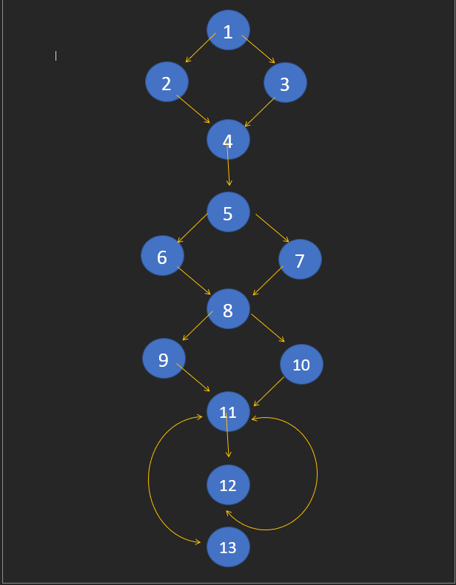
1). ec = E – N + 2
E = 16 N = 13
ec = 16-13 + 2
ec = 5
2). Total No of Region = 5
3). V(G) = P+1 (WHERE P IS TOTAL NO OF PREDICATE NODES CONTAINED IN FLOW G)
P = 4
V(G) = 4 + 1 = 5
The Cyclometric Complexity is 5 for Given Code.

